Slide 1
Figure 4-1

Slide 2
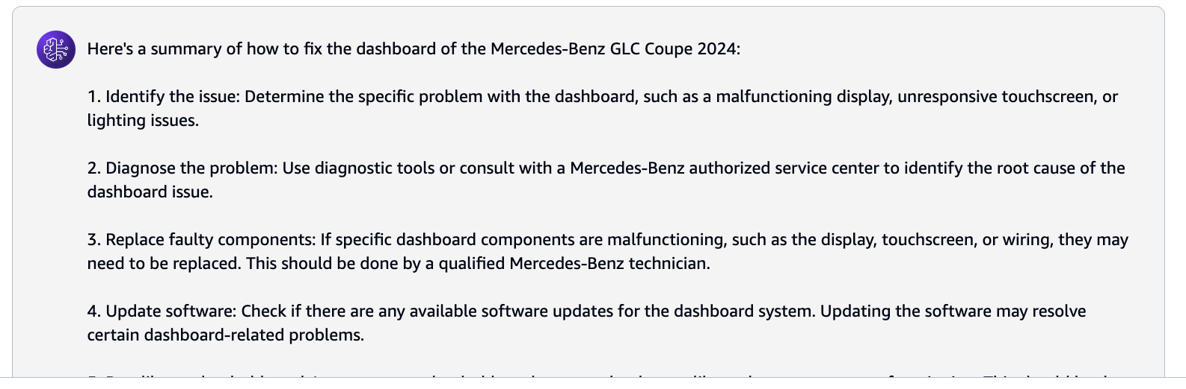
Prompt ( how to fix the dashboard of the Mercedes-Benz GLC Coupe 2024 )
Foundation Model
Response ( completion)

Slide 3
Figure 4-2

Slide 4
Prompt ( Text type)
Foundation Model ( Text-2-Text type )
Completion ( Text type)
Text based Prompts
Prompt ( Text type)
Foundation Model ( Text-2-Image type )
Completion ( Image type)
Image based Prompts
Prompt ( Text + Image or Video file etc)
Foundation Model ( Text-2-Text type )
Completion ( Image or Text type etc)
Multimodel Prompts

Slide 5
Figure 4-3

Slide 6
prompt
Instructions: Summarize the book review feedback
Role: Architect
Context: Technology Book
Review: recently had the pleasure of exploring this technology book, and I must say, I was thoroughly impressed. The variety and depth of chapters available are truly remarkable. In particular, I was delighted to discover some rare knowledge that I have been fervently searching for. This book that caught my attention was particularly relevant to my profession as a software architect. Its content provided valuable insights and perspectives that I found immensely beneficial for my work. However, I also noted that while the book was enriching for individuals in the software architect domain, it may appear somewhat convoluted for members of the developer community. Perhaps offering supplementary materials or resources to support a clearer understanding of complex concepts could enhance the accessibility of such content to a wider audience.
Negative Prompt: Developer Role
Summary:

Slide 7
Outcome from the Foundation Model ( completion)

Slide 8
Figure 4-4

Slide 9
prompt
Instructions: generate sentiment the book review feedback
Context: Technology Book
Review: recently had the pleasure of exploring this technology book, and I must say, I was thoroughly impressed. The variety and depth of chapters available are truly remarkable. In particular, I was delighted to discover some rare knowledge that I have been fervently searching for. This book that caught my attention was particularly relevant to my profession as a software architect. Its content provided valuable insights and perspectives that I found immensely beneficial for my work. However, I also noted that while the book was enriching for individuals in the software architect domain, it may appear somewhat convoluted for members of the developer community. Perhaps offering supplementary materials or resources to support a clearer understanding of complex concepts could enhance the accessibility of such content to a wider audience.
sentiment:

Slide 10
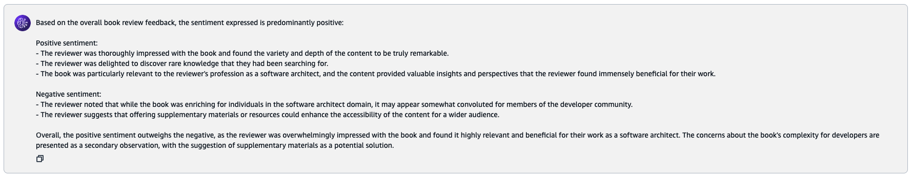
Outcome from the Foundation Model ( completion)

Slide 11
Figure 4-5

Slide 12
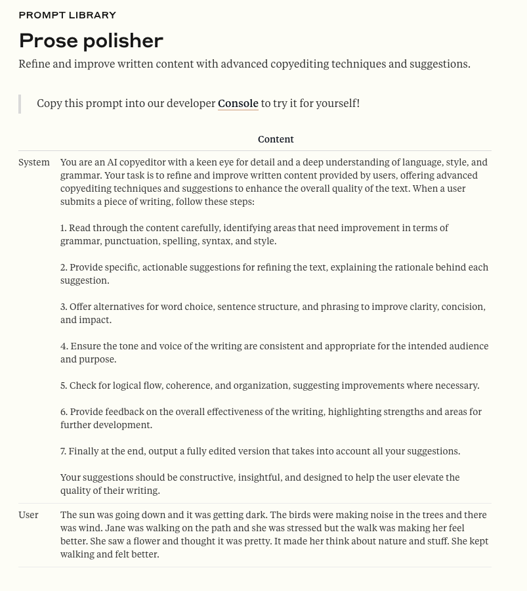

Slide 13
Figure 4-6

Slide 14
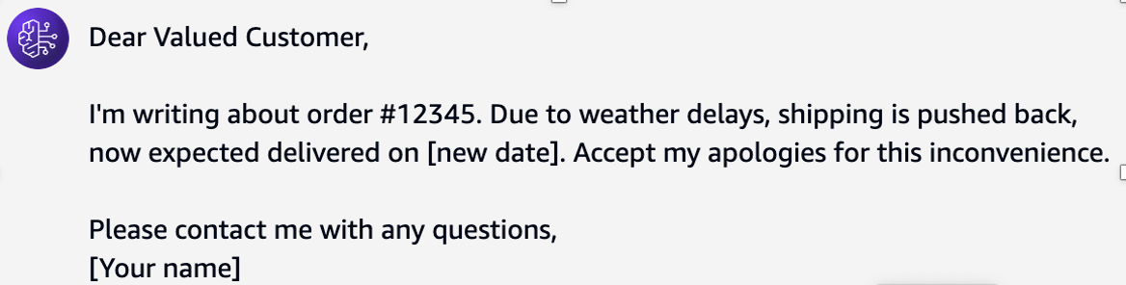
prompt
Generative AI Model
Agent: Write an email informing a customer of a delivery delay within 30 words
Outcome from the Foundation Model ( completion)

Slide 15
Figure 4-7

Slide 16
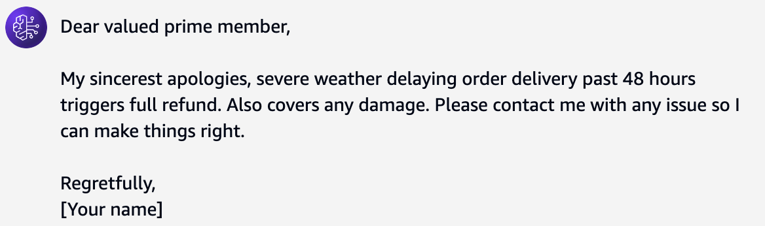
prompt
Agent: Compose an apologetic email to a customer regarding a shipping delay of a purchased product within 30 words. Include politeness and these details:
Severe weather affected the transportation.
Customer is eligible full refund if delay in delivery exceeds 48 hours.
Customer is eligible full refund ff the product gets damaged during delivery.
The customer has prime purchase status.
Generative AI Model
Outcome from the Foundation Model ( completion)

Slide 17
Figure 4-8

Slide 18
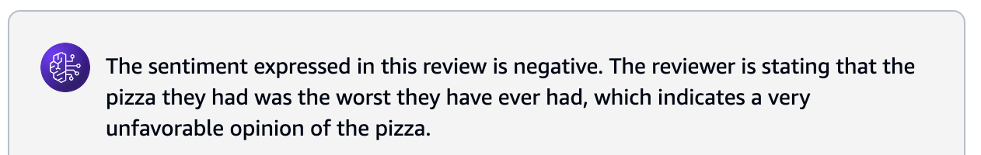
prompt
Review: This pizza is the worst I've ever had.
Sentiment:
Generative AI Model
Outcome from the Foundation Model ( completion)

Slide 19
Figure 4-9

Slide 20
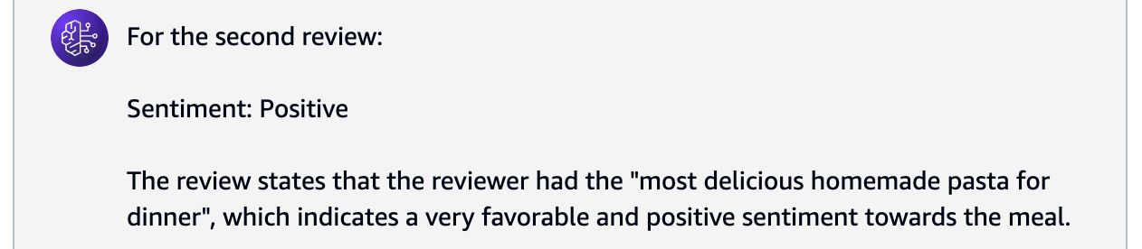
prompt
Review: This pizza is the worst I've ever had.
Sentiment: Negative
Review: Just had the most delicious homemade pasta for dinner.
Sentiment:
Generative AI Model
Outcome from the Foundation Model ( completion)

Slide 21
Figure 4-10

Slide 22
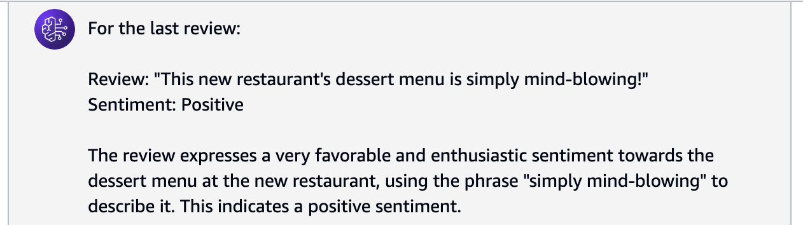
prompt
Review: This pizza is the worst I've ever had.
Sentiment: Negative
Review: Just had the most delicious homemade pasta for dinner.
Sentiment: Positive
Review: I'll send you the recipe for that amazing chocolate cake.
Sentiment: Neutral
Review: This new restaurant's dessert menu is simply mind-blowing!
Sentiment:
Generative AI Model
Outcome from the Foundation Model ( completion)

Slide 23
Figure 4-11

Slide 24
prompt
On a given week during Xmas, the footfall of visitors of a famous city mall were Monday: 20000 visitors Tuesday: 21000 visitors Wednesday: 22000 visitors There is trend that same average visitors footfall during the weekend.
Question: How many visitors can we expect on Friday?
Answer: Based on the numbers given and without any more information, there is a daily decrease of 1000 visitors. If we assume this trend will continue during the following days, we can expect 22000 visitors on the next day that would be Thursday, and therefore 23000 visitors on the next day that would be Friday.
Question: How many visitors can we expect on Saturday and Sunday? (Think Step-by-Step)
Answer:

Slide 25
Outcome from the Foundation Model ( completion)
Okay, let's think through the answer to the second question step-by-step:
Question: How many visitors can we expect on Saturday and Sunday?
Step 1: Analyse the given information
- The visitor footfall on Monday was 20,000
- The visitor footfall on Tuesday was 21,000
- The visitor footfall on Wednesday was 22,000
- There is a trend of the same average visitor footfall during the weekend
Step 2: Determine the expected visitor footfall on Thursday and Friday
- The answer states that based on the daily decrease of 1,000 visitors, the expected visitor footfall on Thursday would be 22,000 and on Friday would be 23,000.
Step 3: Estimate the expected visitor footfall on Saturday and Sunday
- Since the question states that there is a trend of the same average visitor footfall during the weekend, we can assume that the average of the weekday visitor footfall would apply to the weekend as well.
- The average of the weekday visitor footfall is (20,000 + 21,000 + 22,000 + 23,000) / 4 = 21,500 visitors.
Step 4: Conclude the expected visitor footfall on Saturday and Sunday
- Based on the assumption of the same average visitor footfall during the weekend, we can expect 21,500 visitors on both Saturday and Sunday.
In summary, the answer is:
Saturday: 21,500 visitors
Sunday: 21,500 visitors
The key assumption made is that the trend of the same average visitor footfall during the weekend holds true.

